Slide 1
SCADA TRAINING
SCADA
AJAY K BASU
akbasu48@gmail.com

Slide 2
What is SCADA?
Acronym for
Supervisory Control And Data Acquisition
used to monitor and control a plant or
equipment in industries such as
telecommunications, water and waste control,
energy, oil & gas, refining and transportation.

Slide 3
What is SCADA?
2
SCADA is not a specific technology, but a type of application.
Any application that gets data about a system in order to control that system is a SCADA application.

Slide 4
What is SCADA?
3
A collection of standard and/or custom software [sometimes called Human Machine Interface (HMI) software or Man Machine Interface (MMI) software] systems used to provide the SCADA central host and operator terminal application, support the communications system and monitor and control remotely located field data interface devices

Slide 5
SCADA Functions
In simple terms, SCADA performs the following four functions
1. Data acquisition
2. Networked data communication
3. Data presentation
4. Control

Slide 6
SCADA Components
1
Sensors and Actuators
Sensors convert input parameters of the managed system (like temperature or angle of rotation) to measurable digital or analog electrical signals
Actuators (e.g. control relays) generate proper signals to perform the control function

Slide 7
SCADA Components
2
Remote telemetry units (RTUs)/PLCs
These are small computerized units deployed in the field at specific sites and locations.
RTUs serve as local collection points for gathering data from sensors and delivering commands to actuators.

Slide 8
SCADA Components
3
Host Computer
A central computer server or servers sometimes called a SCADA Center, master station, or Master Terminal Unit (MTU) with large interactive terminals for display and control which act as human interface

Slide 9
SCADA Components
3
Host Computer
The central host computer or master station is most often a single computer or a network of computer servers that provide a man-machine operator interface to the SCADA system.

Slide 10
SCADA Components
3
Host Computer
The computers process the information received from and sent to the RTU sites and present it to human operators in a form that the operators can work with.

Slide 11
SCADA Components
3
Host Computer
Operator terminals are connected to the central host computer by a LAN/WAN so that the viewing screens and associated data can be displayed for the operators.

Slide 12
SCADA Components
3
Host Computer
The central host computer acts as a server for the SCADA application, and the operator terminals are clients that request and send information to the central host computer based on the request and action of the operators.

Slide 13
SCADA Components
4
Communications Network
It is intended to provide the means by which data can be transferred between the central host computer servers and the field-based RTUs.
The Communication Network refers to the equipment needed to transfer data to and from different sites. The medium used can either be cable, telephone or radio.

Slide 14
SCADA Components
4
Communications Network
Cables are used for an application with small geographical coverage.
For larger areas telephone line (leased or dial up) is a more economic solution

Slide 15
SCADA Components
4
Communications Network
For remote sites, the use of radio offers an
economical solution. Radio modems are used to
connect the remote sites to the host.
An on-line operation can also be implemented
on the radio system. For locations where a
direct radio link cannot be established, a radio
repeater is used to link these sites.

Slide 16
SCADA Components
4
Communications Network
With increased deployment of office LANs and
WANs (internet) as a solution for interoffice
computer networking, SCADA LANs are being
integrated into everyday office computer
networks.

Slide 17
SCADA Components
4
Communications Network
The foremost advantage of local or wide area networking is that there is no need to invest in a separate computer network for SCADA operator terminals.
In addition, there is an easy path to integrating SCADA data with existing office applications, such as spreadsheets, work management systems, data history databases, Geographic Information System (GIS)systems and water distribution modelling systems.

Slide 18
SCADA Host/HMI
HMI sits on the operating system which is usually an UNIX version (e.g. LINUX).
However, modern windows-based SCADA are becoming increasingly popular, which makes development and integration with external world a much easier exercise.

Slide 19
SCADA Software
Typical software used in the SCADA system are:
Central host computer operating system (UNIX/Windows)
Operator terminal operating system
(UNIX/Windows)

Slide 20
SCADA Software
Central host computer application
Software that handles the transmission and
reception of data to and from the RTUs and the
central host.
The software also provides the graphical user interface which offers site mimic screens, alarm pages, trend pages and control functions

Slide 21
SCADA Software
Common features of central host
computer application
Dynamic Process Graphics
Trending - Real Time and Historical
Alarms
Recipe Management
Security

Slide 22
SCADA Software
Common features of central host
computer application
Device Connectivity
Script for logic development
Database connectivity

Slide 23
SCADA Software
Operator terminal application
Application that enables users to access
information available on the central host
computer application. It is usually a subset
of the software used on the central host computers.

Slide 24
SCADA Software
Communications protocol drivers
Software that is usually based within the central
host and the RTUs, and is required to control the
translation and interpretation of the data between
ends of the communications links in the system.
The protocol drivers prepare the data for use either at
the field devices or the central host end of the system.

Slide 25
SCADA Software
Communications network management software
Software required to control the
communications network and to allow the
communications networks themselves to be
monitored for performance and failures.

Slide 26
SCADA Software
RTU automation software
Software that allows engineering staff to configure and maintain the application housed within the RTUs (or PLCs).
Most often this includes the local automation application and any data processing tasks that are performed within the RTU.

Slide 27
SCADA Architectures
Three levels:
Supervisory level
Contains Master Station, Communication and Data Base Servers and Switches
Control or controller level
PLC/RTU/PAC
Field or Device level
Field Instruments, sensors, drive and other actuating devices

Slide 28
SCADA Architectures
1
Monolithic SCADA
Distributed SCADA
Networked SCADA

Slide 29
SCADA Architectures
2
Monolithic SCADA
Centred around mainframe computers
Standalone systems
Connectivity with external world and RTUs using vendor-specific proprietary protocols
No networking

Slide 30
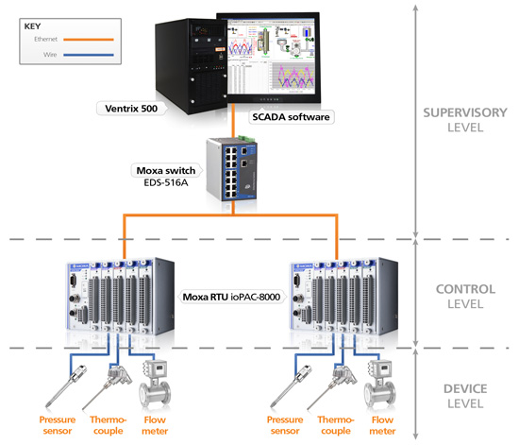

Slide 31
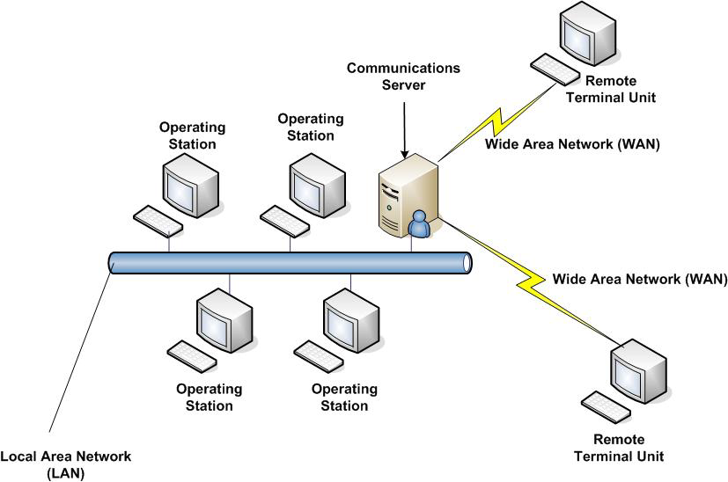

Slide 32
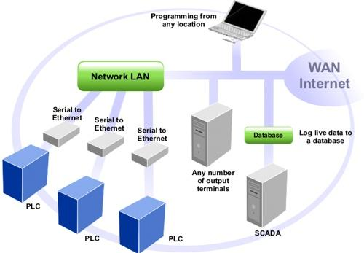

Slide 33
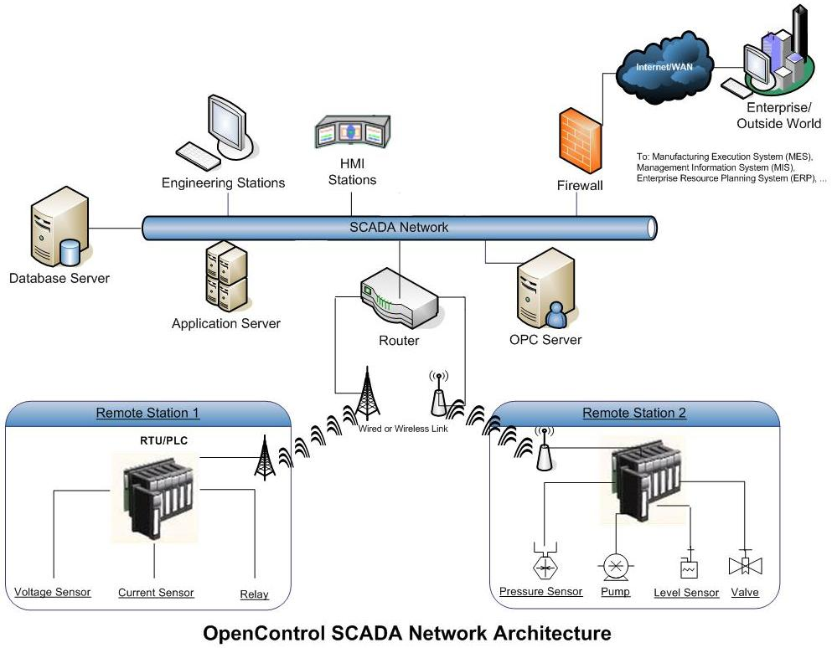

Slide 34
SCADA Architectures
Distributed SCADA
Distributes the functionalities among multiple servers connected by LAN. Each server is low cost minicomputer/ high-end PC Server.
Functionalities are Communication Service, HMI, Data Base Service, Data Processing Service etc.

Slide 35
SCADA Architectures
3
Networked SCADA
Open architecture against earlier vendor controlled proprietary environment.
Allows use of standard third-party hardware/software conforming to open system
Allows functionalities of Master System to be geographically distributed over WAN as against local area connectivity in the distributed system. For example, Communication Server may be away from the Master Station connected through IP

Slide 36
SCADA Protocols and Standards
In this section, we try to find answer to:
What is a protocol?
Why Protocols and Standards are important
Who makes standards?
Communication Standards for SCADA

Slide 37
SCADA Protocols and Standards
All communications between devices require that the devices agree on the format of the data and information exchange sequence. The set of rules defining this is called a protocol.
Protocols allow different vendors to manufacture equipments which are compatible with all equipments conforming to the protocol. For example, any MODBUS controller from vendor X will work with a MODBUS instrument from vendor Y.

Slide 38
SCADA Protocols
2
A SCADA system has three major sub-systems - Master Station, Controllers and Field Instruments. Hence three major communications in case of SCADA are:
1. Between Master Station and External World
2. Between Controlling Station (RTU/PLC/PAC) and
Master Station
3. Between Field Instrument and Controlling Station

Slide 39
SCADA Protocols
3
Proprietary Standard
Industry Practice - Informal Practice
Industry Standard - Formal Practice
National Standards e.g. ANSI, IEEE
International Standards e.g. ISO, IEC

Slide 40
SCADA Protocols
4
ISO
ISO stands for International Organization of Standardization. ISO-OSI is a conceptual model for Open System Interconnection (OSI) and is commonly known as OSI model.

Slide 41
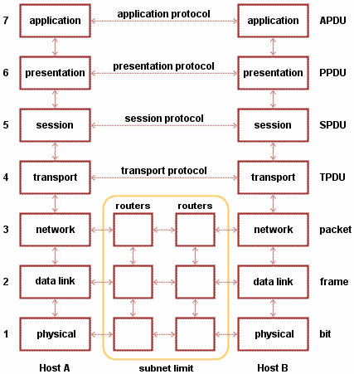
SCADA Protocols OSI Model
5

Slide 42
SCADA Protocols
6
IEC
International Electrotechnical Commission (IEC) is a non-profit non-govt. international standards organization that sets standards and protocols for a very wide range of Electric and Electronic devices and communications.
Some IEC standards related to SCADA are described in the next section.

Slide 43
SCADA Protocols
7
MODBUS
Most popular of the communication protocols used in SCADA, MODBUS is an application layer (Level 7 of OSI model) messaging protocol that provides Master-Slave/Client-Server communication between devices connected on different types of buses or networks.
In simple terms, it is a method used for transmitting information over serial lines between electronic devices. In SCADA, it is used in communication between Host Station and Controller (RTU/PLC/PAC), where Host Station is the Master. It is also used in communication between Controller and Field Instrument, where Controller is the Master.
Originally developed for only serial messaging, the protocol has been expanded to include implementations over Serial, TCP/IP and the User Datagram Protocol (UDP).

Slide 44
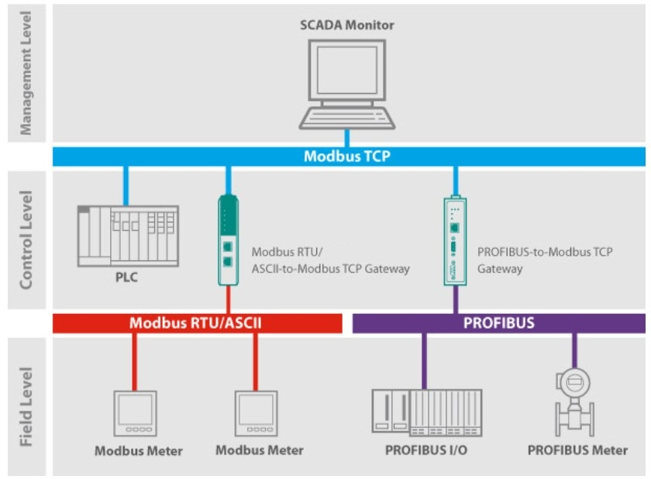
SCADA Protocols
8 MODBUS

Slide 45
SCADA Protocols
9
IEEE 802.3 Ethernet
The term Ethernet refers to the family of local-area network (LAN) products covered by the IEEE 802.3 standard that defines what is commonly known as the CSMA/CD protocol. Three data rates are currently defined for operation over optical fiber and twisted-pair cables:
10 Mbps 10Base-T Ethernet
100 Mbps Fast Ethernet
1000 Mbps Gigabit Ethernet
Is easy to understand, implement, manage, and maintain
Allows low-cost network implementations
Provides extensive topological flexibility for network installation
Guarantees successful interconnection and operation of
standards- compliant products, regardless of manufacturer

Slide 46
SCADA Protocols
10
TCP/IP
TCP/IP stands for Transmission Control Protocol/Internet Protocol, which is a set of networking protocols that allows two or more computers to communicate.
Since all modern controllers and many field instruments have built-in Microprocessors/Microcontrollers, TCP/IP is widely used in today’s SCADA applications, particularly for remote control and monitoring over wide area network.

Slide 47
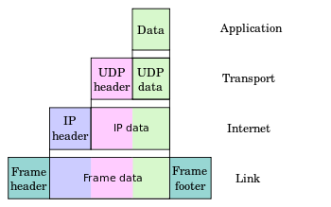
SCADA Protocols
11
TCP/IP

Slide 48
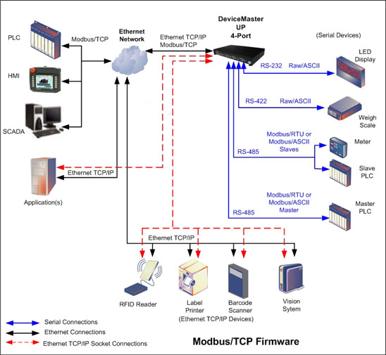
SCADA Protocols
12
TCP/IP

Slide 49
SCADA Protocols
13
TCP/IP
TCP/IP stands for Transmission Control Protocol/Internet Protocol, which is a set of networking protocols that allows two or more computers to communicate.
Since all modern controllers and many field instruments have built-in Microprocessors/Microcontrollers, TCP/IP is widely used in today’s SCADA applications, particularly for remote control and monitoring over wide area network.

